Slide 1

MICROSERVICES

Slide 2
What is Microservices Architecture?
Microservices, or microservices architecture, is a cloud-native architectural approach in which a single application is composed of many loosely coupled and independently deployable smaller components or services.
Microservices are a popular architectural style for building applications that are resilient, highly scalable, independently deployable, and able to evolve quickly. Building a successful microservices architecture requires a fundamental shift in mindset. It goes beyond decomposing an application into smaller services. You must also rethink how systems are designed, deployed, and operated.
Microservices architecture (often shortened to microservices) refers to an architectural style for developing applications. Microservices allow a large application to be separated into smaller independent parts, with each part having its own realm of responsibility. To serve a single user request, a microservices-based application can call on many internal microservices to compose its response.
A microservices architecture is a type of application architecture where the application is developed as a collection of services. It provides the framework to develop, deploy, and maintain microservices architecture diagrams and services independently.

Slide 3
What is Microservices Architecture?
Microservices typically:
Have their own technology stack, inclusive of the database and data management model.
Communicate with one another over a combination of representational state transfer (REST) APIs, event streaming and message brokers.
Are organized by business capability, with the line separating services often referred to as a bounded context.

Slide 4
How do microservices benefit the organization?
01
02
03
Independently deployable
Speed isn’t the only value of designing services this way. A common emerging organizational model is to bring together cross-functional teams around a business problem, service, or product.
Right tool for the job
Technology changes constantly, and an application composed of multiple, smaller services is much easier and less expensive to evolve with more desirable technology as it becomes available.
Precise scaling
Done correctly, microservices require less infrastructure than monolithic applications because they enable the precise scaling of only the components that require it, rather than the entire application, as is the case with monolithic applications.

Slide 5
Microservices both enable and require DevOps
Microservices architecture is often described as optimized for DevOps and continuous integration or continuous delivery, and in the context of small services that can be deployed frequently, it’s easy to understand why.
DevOps complements microservices architecture by providing practices and tools that facilitate effective development, deployment, and management of microservices. Here’s how:
Faster Delivery: DevOps practices like CI/CD streamline the deployment process, allowing microservices to be updated and released faster. This aligns with the independent deployment model of microservices.
Enhanced Collaboration: DevOps promotes a culture of collaboration, making it easier for cross-functional teams to work on different microservices simultaneously, speeding up development cycles.
Automation of Processes: Automation in DevOps enables continuous testing and integration of microservices, ensuring that new features are thoroughly vetted before deployment.
Feedback Loops: DevOps encourages real-time monitoring and feedback, which is critical for microservices. Teams can quickly address issues with individual services, improving overall application reliability.
Infrastructure as Code (IaC): IaC practices allow teams to manage infrastructure through code, making it easier to deploy and manage microservices across various environments consistently.

Slide 6

Key enabling tools and technologies

Slide 7
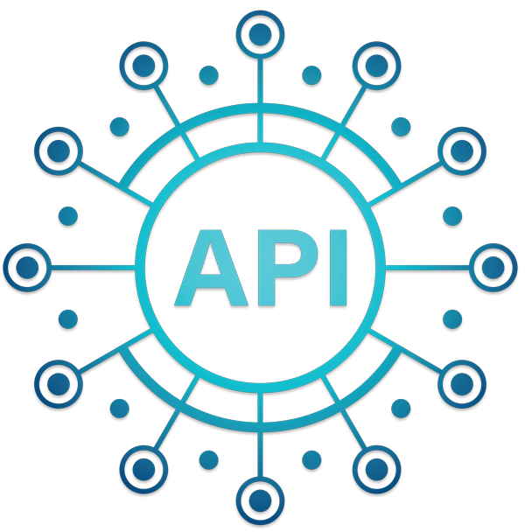
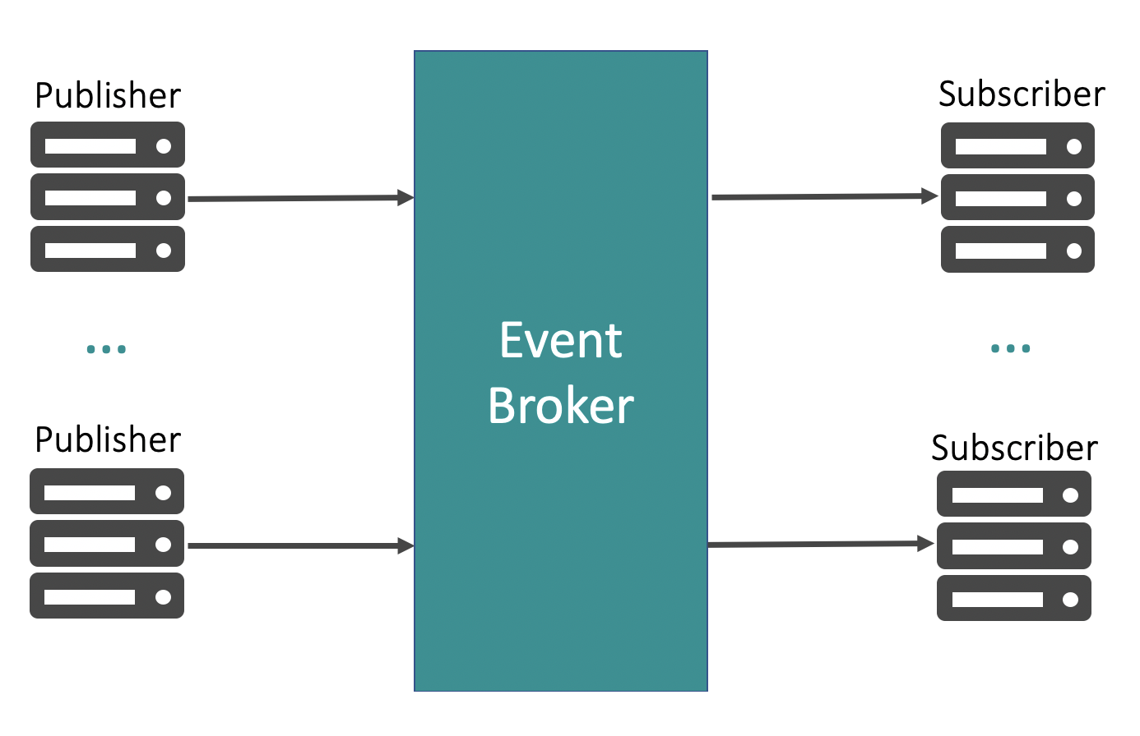
Containers, Docker, and Kubernetes
Individual containers don’t have the overhead of their own operating system, making them a perfect match for the smaller and lighter-weight services found within microservices architectures.
Kubernetes, an open-source container orchestration platform, has emerged as one of the most popular orchestration solutions because it does that job so well.
API gateways
An API gateway acts as a reverse proxy for clients by routing requests, fanning out requests across multiple services, and providing additional security and authentication.
Messaging and event streaming
It is necessary to couple state-establishing API calls with messaging or event streaming so that services can broadcast state changes.
By combining microservices with event-driven architecture, developers can build distributed, highly scalable, fault-tolerant, and extensible systems that can consume and process large amounts of events or information in real time.

Slide 8
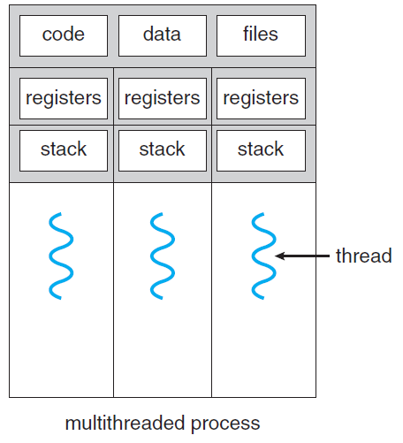
The idea of API Gateway:
Service
Service
Now we have these processes running simultaneously; in other words, the processes are parallel
Since we have running instances, we need communication, so we need something shared at this time; it will be the network, not RAM
Two main parts will guide our design: the HTTP request and how the data transfers through the network (JSON)
Since our apps communicate through the network, we are doing network/web programming.
Now we need an API Gateway, which is a software layer that presents a single entry point for clients (such as web or mobile applications) to access multiple backend services, while simultaneously managing client/server interactions.
Service
Service

Slide 9
The idea of API Gateway:
Service
Service
Service
Service
Service
Service
Service
Service
Service
Service
API Gateway

Slide 10
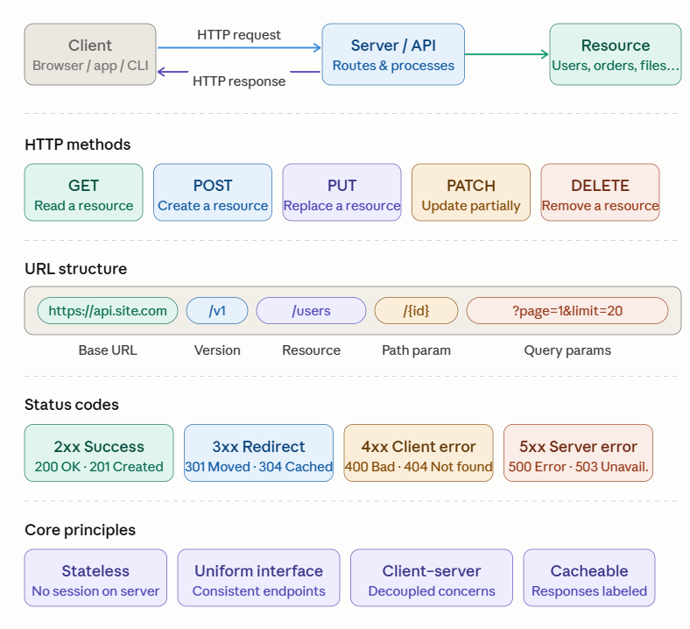
The REST API:

Slide 11
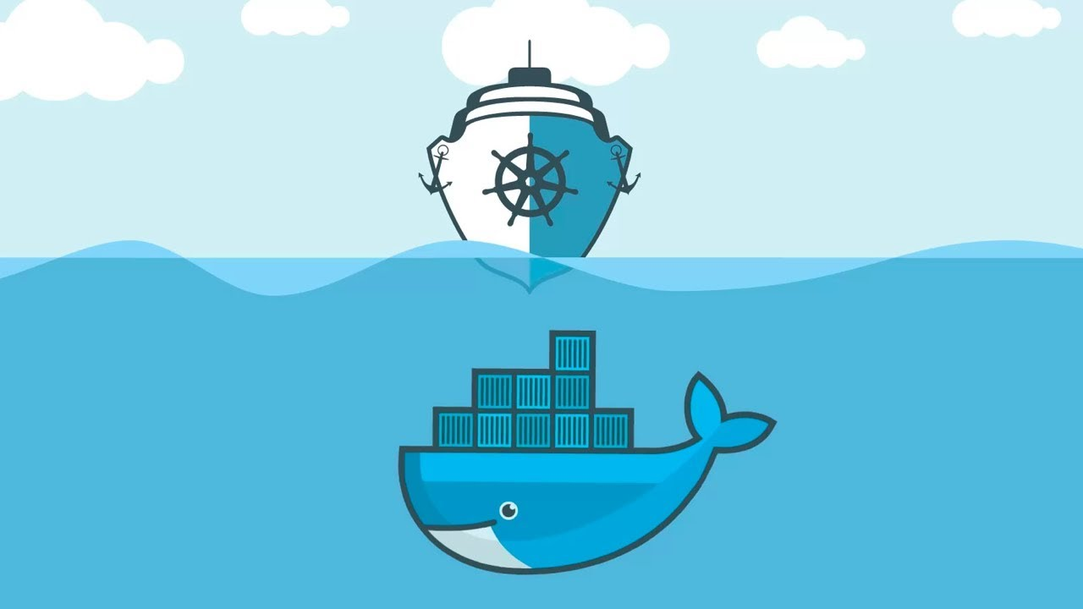
Kubernetes

Slide 12
Kubernetes defined (Since 2014, by Google):
Kubernetes, also known as k8s or kube, is an open-source container orchestration platform for scheduling and automating the deployment, management and scaling of containerized applications.
As containers proliferated, today, an organization might have hundreds or thousands of them. Operations teams are needed to schedule and automate container deployment, networking, scalability, and availability. Enter container orchestration.
In a CNCF report, Kubernetes is the second largest open-source project in the world (after Linux) and the primary container orchestration tool for 71% of Fortune 100 companies.
In 2018, Kubernetes was the CNCF’s first graduate project, becoming one of the fastest-growing open-source projects in history. While other container orchestration options, most notably Docker Swarm and Apache Mesos, gained some traction early on, Kubernetes quickly became the most widely adopted.

Slide 13
Kubernetes schedules and automates container-related tasks throughout the application lifecycle:
Deployment: Deploy a specified number of containers to a specified host and keep them running in a desired state.
Rollouts: A rollout is a change to a deployment. Kubernetes lets you initiate, pause, resume, or roll back rollouts.
Service discovery: Kubernetes can automatically expose a container to the internet or to other containers by using a domain name system (DNS) name or IP address.
Storage provisioning: Set Kubernetes to mount persistent local or cloud storage for your containers as needed.
Load balancing: Based on CPU usage or custom metrics, Kubernetes load balancing can distribute the workload across the network to maintain performance and stability.
Autoscaling: When traffic spikes, Kubernetes autoscaling can spin up new clusters as needed to handle the additional workload.
Self-healing for high availability: When a container fails, Kubernetes can restart or replace it automatically to prevent downtime. It can also take down containers that don’t meet your health check requirements.

Slide 14
Kubernetes architecture and components:
Ingress: Acts like the domain and the bundle of the services.
Service: Permanent IP address. Lifecycle of pod and service not connected, so even if the pod dies, the service and its IP address will stay.
Pod: the smallest unit of K8S and is ephemeral. Usually meant to run one app container.
Service
My APP [Container]
IP
K8S offers out of the box a virtual network which means that each pod gets its own IP address not the container.
DB [container]
But the pod is ephemeral
Service
IP
NODE

Slide 15
References:
https://learn.microsoft.com/en-us/azure/architecture/guide/architecture-styles/microservices
https://cloud.google.com/learn/what-is-microservices-architecture
https://www.ibm.com/think/topics/microservices
https://www.ibm.com/think/topics/rest-apis
https://www.ibm.com/think/topics/api-gateway
https://www.ibm.com/think/topics/kubernetes
https://www.youtube.com/watch?v=X48VuDVv0do

Slide 16
THANK YOU

